Slide 1
Hough circle transform
Sheela Ahmed

Slide 2
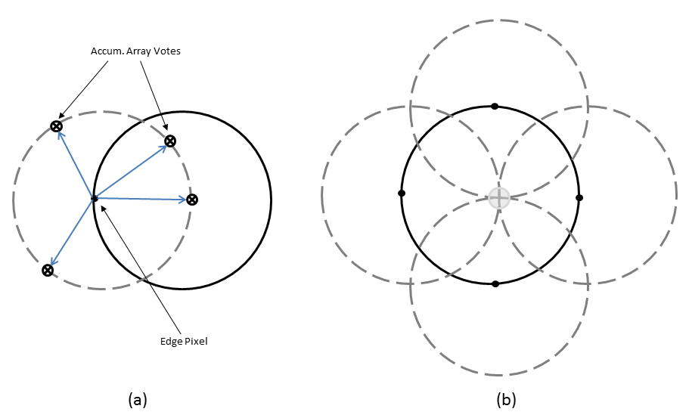
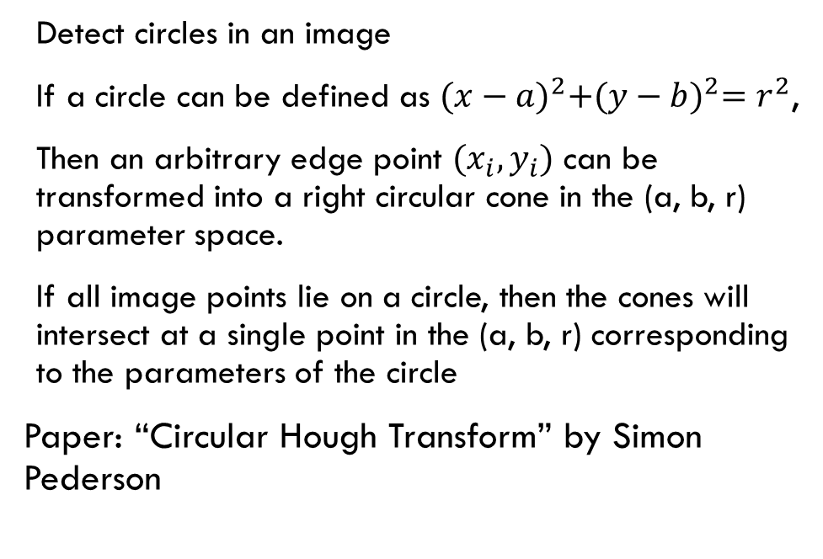
What is hough circle transform?
Detect circles in an image
If a circle can be defined as ${(x−a)}^{2}+{(y−b)}^{2}=r^{2}$,
Then an arbitrary edge point $(x_{i},y_{i})$ can be transformed into a right circular cone in the (a, b, r) parameter space.
If all image points lie on a circle, then the cones will intersect at a single point in the (a, b, r) corresponding to the parameters of the circle
Paper: “Circular Hough Transform” by Simon Pederson
https://www.mathworks.com/help/images/ref/imfc_accumarray.png

Slide 3

http://www.aishack.in/tutorials/circle-hough-transform/

Slide 4

http://www.aishack.in/tutorials/circle-hough-transform/

Slide 5
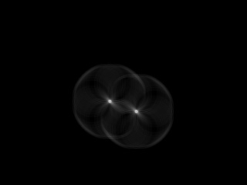
http://www.aishack.in/tutorials/circle-hough-transform/

Slide 6
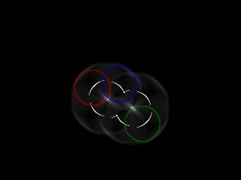
http://www.aishack.in/tutorials/circle-hough-transform/

Slide 7
General steps for algorithm
Find edges in the image
Create circles around each edge pixel
Create an accumulator list that counts when a certain pixel matches two circles
Maximum count value can be inferred as the center of a circle in the image
Need to determine which radius value to use to test
Create a range of radii to go through

Slide 8
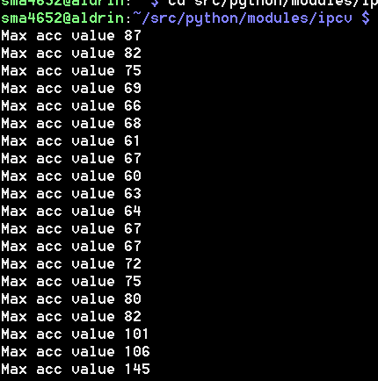

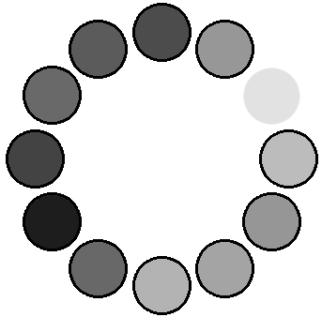
First iteration of code took ~11 minutes…

Slide 9
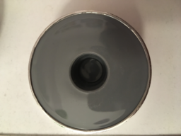
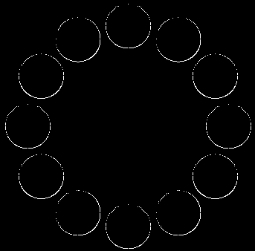
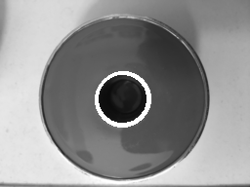
Synthetic image
Real world image

Slide 10
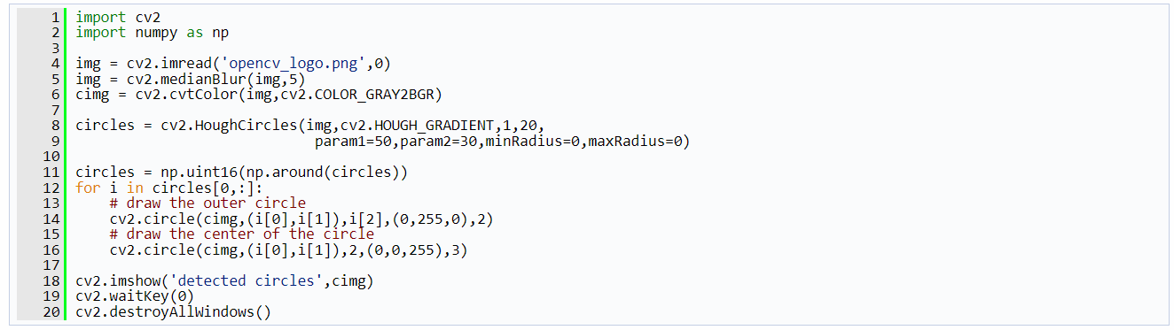

There’s an opencv function
cv2.HoughCircles(image, method, circles, minDist, param1, param2, minRadius, maxRadius)

Slide 11
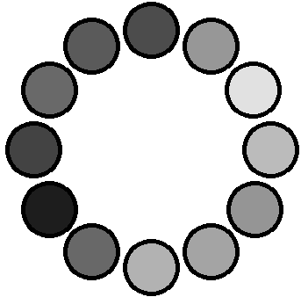
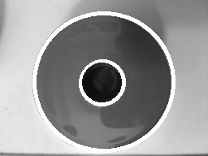
using opencv hough transform

Slide 12
references
http://www.aishack.in/tutorials/circle-hough-transform/
https://www.mathworks.com/help/images/ref/imfc_accumarray.png
Pedersen, Simon Just Kjeldgaard. "Circular hough transform." Aalborg University, Vision, Graphics, and Interactive Systems123 (2007): 123.

